Slide 1
Credit Risk Management
Machine Learning Assisted Rational Decision-Making

Slide 2
1: Executive Summary
GOAL
Boost profitability and reduce credit risk using predictive systems, aiming for increased revenue, lower default rates, and strategic flexibility through threshold adjustments.
TOOL
An advanced machine learning model designed to assess the likelihood of loan default among prospective customers.
OUTCOMES
We use a two-pronged strategy for both aggressive and conservative approaches, setting predefined default probability thresholds for customer rejections.
HIGHLIGHT
Our Credit Risk Project leverages cutting-edge machine learning technology, harnessing the power of AI for accuracy and insight.
Strategy | Train Sample |  |  | Test 1 Sample |  |  | Test 2 Sample |  |  | Overall
 | #Total Loans | Default Rate | Revenue | #Total Loans | Default Rate | Revenue | #Total Loans | Default Rate | Revenue | #Total Loans | Default Rate | Revenue
Conservative | 55,893 | 3.170% | 256.136 | 4,911 | 5.925% | 21.324 | 4,847 | 6.561% | 22.151 | 65,651 | 5.219% | 299.612
Aggressive | 60,765 | 6.821% | 317.740 | 5,393 | 9.902% | 27.316 | 5,343 | 11.173% | 28.261 | 71,501 | 9.299% | 373.317

Slide 3
2: Data
Our target variable is binary (1 or 0), signifying customer default or non-default.
We have a dataset with 91k customers from the dataset, chosen for computational ease.
The dataset covers 13 months, from Mar. 2017 to Mar.2018.
The consistent default rate hovers at about 38.89% across these months.
Month | # of Customers | Default Rate
Applications with 1 month of data | 984 | 33.13%
Applications with 2 months of data | 1,217 | 31.22%
Applications with 3 months of data | 1,158 | 35.75%
Applications with 4 months of data | 938 | 43.07%
Applications with 5 months of data | 933 | 39.44%
Applications with 6 months of data | 1,109 | 41.30%
Applications with 7 months of data | 1,046 | 41.49%
Applications with 8 months of data | 1,169 | 45.08%
Applications with 9 months of data | 1,278 | 43.58%
Applications with 10 months of data | 1,329 | 46.58%
Applications with 11 months of data | 1,159 | 44.09%
Applications with 12 months of data | 2,115 | 37.87%
Applications with 13 months of data | 77,348 | 22.94%
Notes:
Grouped by customer ids and then checked the number of records for them because this is monthly data

Slide 4
3&4 : Features &Feature Engineering
Delinquency (D_*): Past payment issues, such as overdue payments, duration of delinquency, and severity.
Spend (S_*): Customer spending patterns, encompassing transaction amounts, merchant categories, and daily spending averages.
Payment (P_*): Customer payment behavior, covering payment amounts and payment frequency.
Balance (B_*): Customer financial balance, including credit limit, current balance, and available credit.
Risk (R_*): Customer credit risk factors, such as credit score, income level, and loan-to-value ratio.
Category | # of features
Spend | 22
Delinquency | 96
Payment | 3
Balance | 40
Risk | 28
Total | 189
Summary statistics of the top 5 features:
Feature Name | Count | Mean | STD | Min | 1% | 5% | Median | 99% | Max | Percent Missing
P_2 | 91,286 | 0.65 | 0.24 | -0.26 | 0.06 | 0.24 | 0.68 | 0.97 | 1.01 | 0.54%
R_1 | 91,783 | 0.08 | 0.16 | 0.00 | 0.00 | 0.00 | 0.01 | 0.43 | 1.75 | 0.00%
B_1 | 91,783 | 0.13 | 0.20 | -0.27 | 0.00 | 0.00 | 0.04 | 0.58 | 1.32 | 0.00%
S_3 | 80,388 | 0.23 | 0.17 | -0.29 | 0.02 | 0.07 | 0.17 | 0.56 | 3.86 | 12.42%
D_42 | 22,553 | 0.18 | 0.24 | 0.00 | 0.00 | 0.01 | 0.12 | 0.57 | 4.19 | 75.43%

Slide 5
3&4 : Features &Feature Engineering – Sample
Sample | % of Total | # of customers | Default Rate
train_data​ | 70% | 78015 | 25.58%
test1_data​ | 15% | 6884 | 25.42%
test2_data​ | 15% | 6884 | 26.63%
Sampling was done randomly
Two test samples have been created:​
The Test samples have been selected to have one test for data before the training set and one for data after the training set.​
Default rate across samples are around the same at 25% so this should be a good split.​

Slide 6
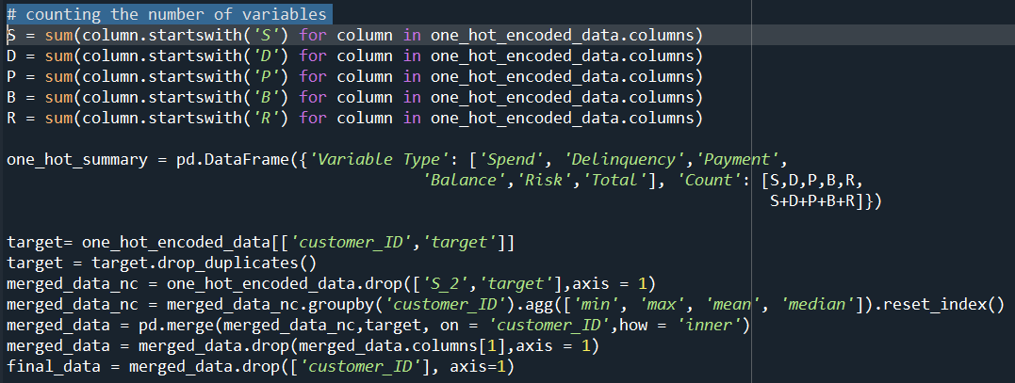

5: Data Processing / One-Hot Encoding
Four categorical variables are present, with Customer_ID and date deemed irrelevant for the model. One-hot encoding has been applied to D_63 and D_64 variables to convert each categorical value into a new categorical column
Compilation process:
The results of One-Hot Encoding
Category | # of features (Before) | # of features (After)
Spend | 22 | 22
Delinquency | 96 | 104
Payment | 3 | 3
Balance | 40 | 40
Risk | 28 | 28
Total | 189 | 197

Slide 7
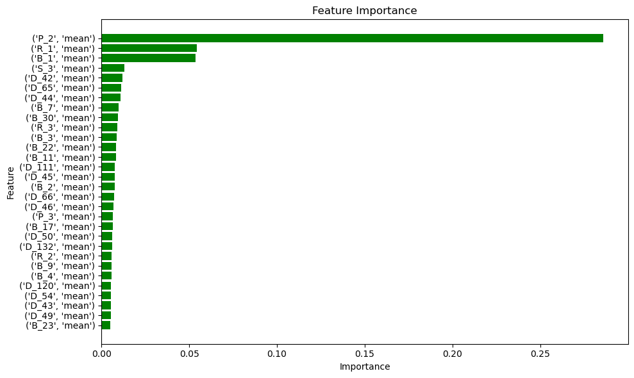
6: Feature Selection
Variable Type | # of features | # selected​
Spend | 22 | 1
Delinquency | 104 | 13
Payment | 3 | 2
Balance | 40 | 11
Risk | 28 | 3
Total | 197 | 31

Slide 8
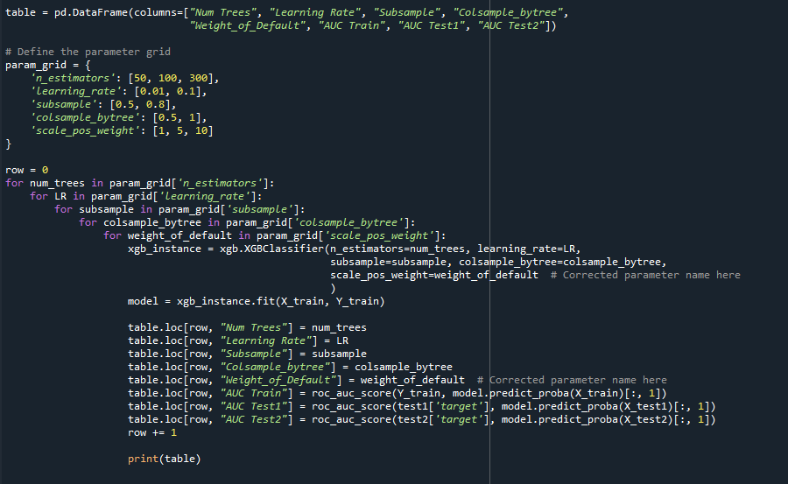
7: XGBoost - Grid Search (1)
In the provided code, a grid search is being conducted to optimize hyperparameters for an XGBoost classifier.
Grid search involves training and evaluating 72 different XGBoost models.
The chosen hyperparameters and their values are based on a balance between model complexity and performance:
'n_estimators' (Number of Trees): [50, 100, 300]
'learning_rate' (Step Size Shrinkage): [0.01, 0.1]
'subsample' (Fraction of Samples for Tree Building): [0.5, 0.8]
'colsample_bytree' (Fraction of Features for Tree Building): [0.5, 1]
'scale_pos_weight' (Weight of the Positive Class): [1, 5, 10]

Slide 9
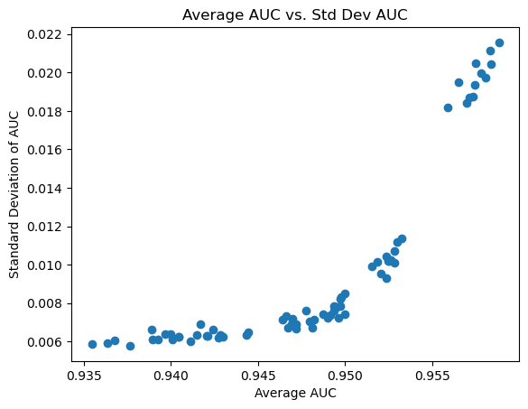
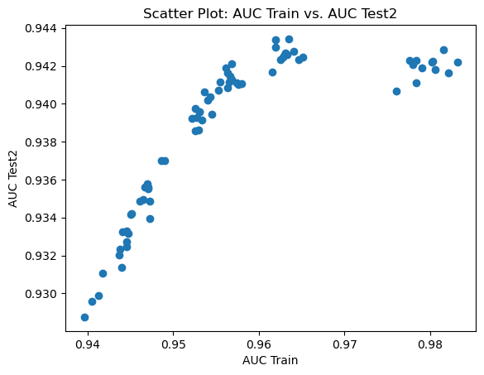
8: XGBoost - Grid Search (2)
We want to choose a model with high average AUC and low standard deviation.
So we would choose models which give us the results between 0.95 and 0.955.
We want to choose a model with high AUC on both Train and Test 2 sample.
So we would choose models which would give us the results between 0.95 - 0.96 AUC on the X-axis.

Slide 10
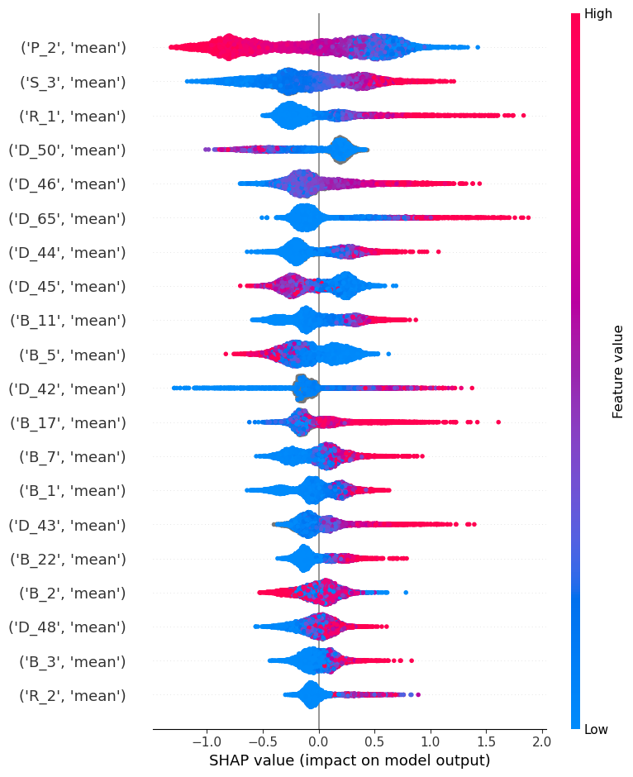
9: XGBoost - SHAP Analysis (1)
Features with positive SHAP values positively impact the prediction, while those with negative values have a negative impact

Slide 11
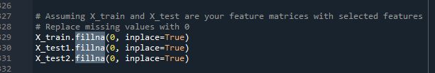
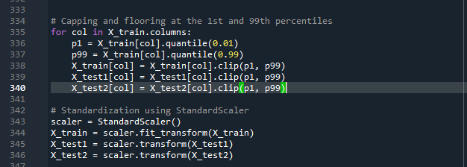
10: Neural Network – Data Processing
All other steps same as Xgboost
Missing value imputation:
3) Normalization and Outlier Treatment:

Slide 12
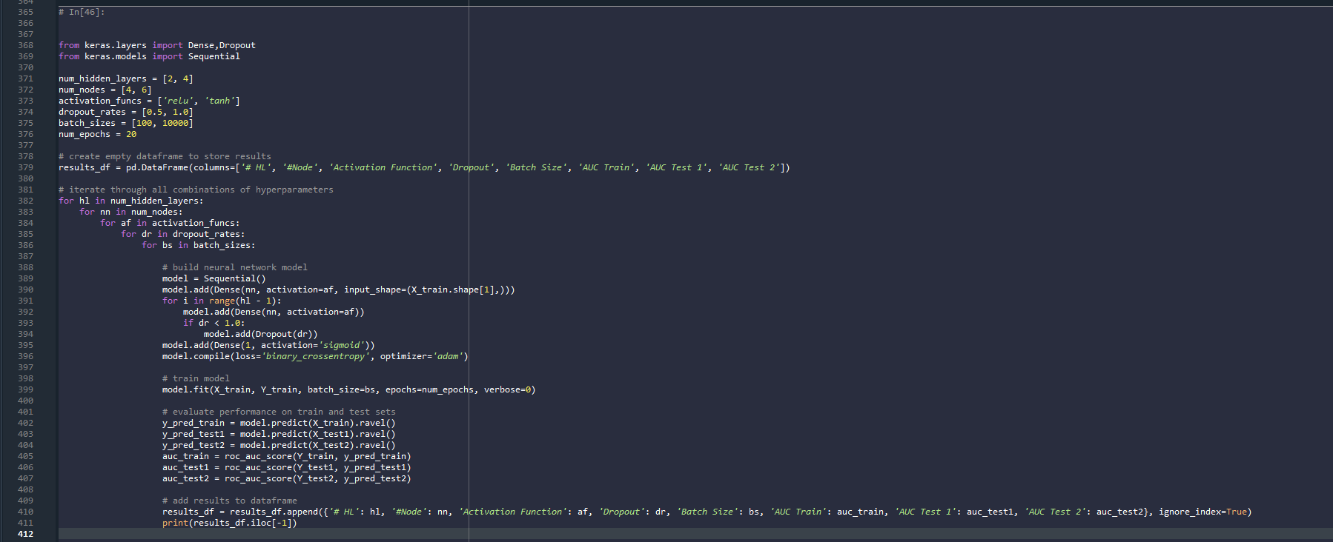
11: Neural Network – Grid Search (1)

Slide 13
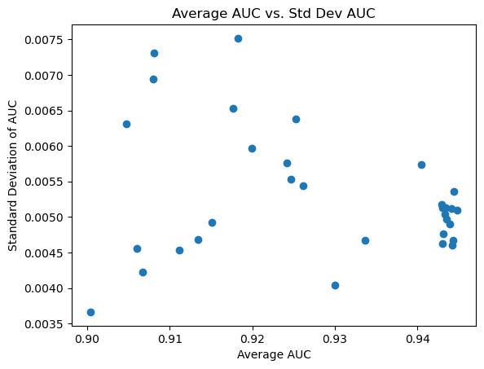
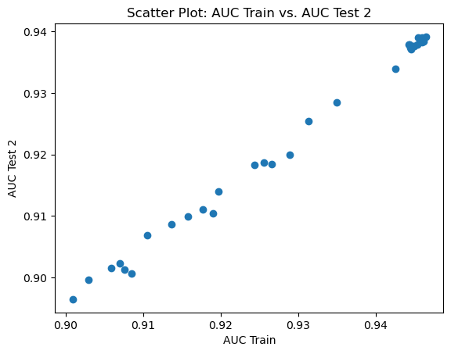
12: Neural Network – Grid Search (2)
Here we want to choose a model with high average AUC and low Standard Deviation.
We would choose models which will give us results greater than 0.94
We want to choose a model with high AUC on both Train and Test 2 sample.
We would choose models which will give us results greater than 0.94

Slide 14
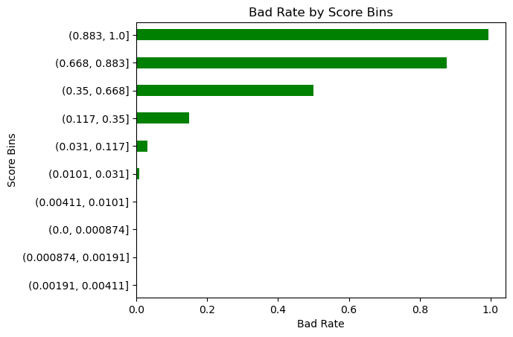
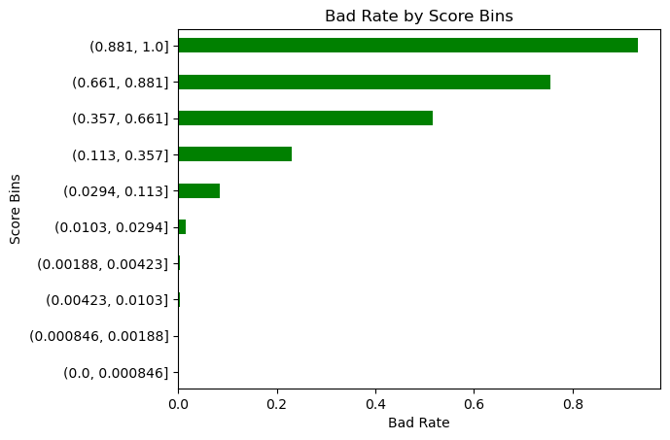
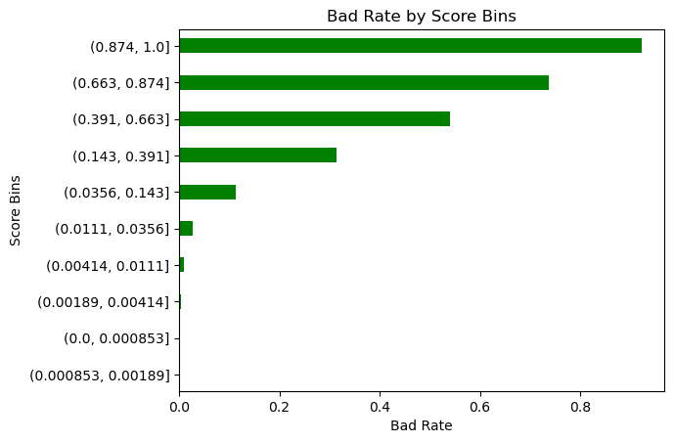
13: XGBoost - Final Model
Trees​ | LR​ | Subsample​ | % Features​ | Weight of Default​ | AUC Train​ | AUC Test 1​ | AUC Test 2​ | Average_AUC​ | AUC_STD​
300 | 0.100 | 0.500 | 0.500 | 1.000 | 0.978 | 0.951 | 0.942 | 0.957 | 0.019

Slide 15
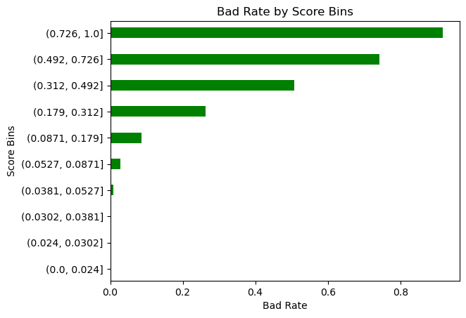
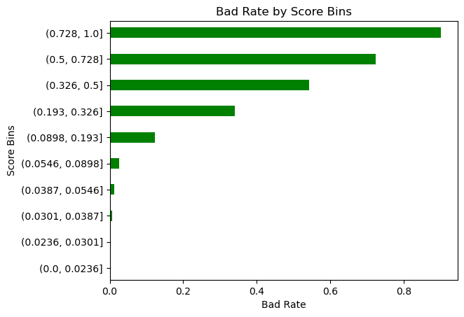
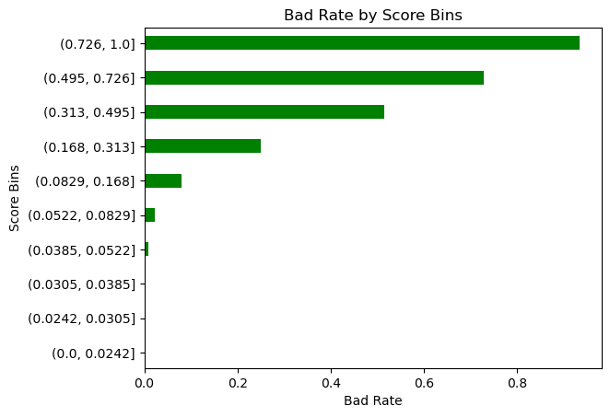
14: Neural Network – Final Model
HL | #Node | Activation Function | Dropout | Batch Size | AUC Train | AUC Test 1 | AUC Test 2 | Average AUC | STd
2 | 4 | relu | 0.500 | 100 | 0.944 | 0.947 | 0.937 | 0.943 | 0.005

Slide 16
15: Final Model
In the Credit Risk project, we ultimately chose the XGBoost (XGB) model as our top-performing model.
This decision was based on the model's slightly superior average AUC performance across different test sets compared to other models and its relatively high stability.
XGBoost demonstrated exceptional performance in handling credit risk, making it the optimal choice for our project.
`Model​ | AUC Train​ | AUC Test 1​ | AUC Test 2​ | Average AUC​ | Variance
XGBoost | 0.983 | 0.952 | 0.943 | 0.948 | 0.01138
​Neural Network​ | 0.946 | 0.949 | 0.939 | 0.927 | 0.00390
XGBoost's AUC on the training set (0.983) is larger than that of the Neural Network (0.946). This indicates that XGBoost fits the training data better in terms of AUC.
XGBoost's AUC on Test 1 (0.952) is slightly larger than that of the Neural Network (0.949). XGBoost performs slightly better on Test 1.
XGBoost's AUC on Test 2 (0.943) is larger than that of the Neural Network (0.939). Again, XGBoost performs slightly better on Test 2.
The average AUC for XGBoost (0.948) is larger than that for the Neural Network (0.927). This means that, on average, XGBoost outperforms the Neural Network across both test sets.
The variance for XGBoost (0.01138) is larger than that for the Neural Network (0.00390). A higher variance suggests that XGBoost's performance varies more across different test sets, while the Neural Network exhibits more consistent performance.

Slide 17
16: STRATEGY IMPLEMENTATION
Threshold | Train |  |  | Test 1 |  |  | Test 2 |  |  | Overall
 | Total Loans | Default Rate | Revenue | Total Loans | Default Rate | Revenue | Total Loans | Default Rate | Revenue | Total Loans | Default Rate | Revenue
0.100 | 45,845 | 0.578% | 147.222 | 4,046 | 1.483% | 12.208 | 3,937 | 1.829% | 12.196 | 53,828 | 1.297% | 171.626
0.200 | 50,346 | 1.263% | 191.834 | 4,433 | 3.023% | 16.026 | 4,318 | 3.520% | 16.254 | 59,097 | 2.602% | 224.114
0.300 | 53,343 | 2.073% | 225.816 | 4,674 | 4.001% | 18.562 | 4,595 | 4.940% | 19.149 | 62,612 | 3.671% | 263.527
0.400 | 55,893 | 3.170% | 256.136 | 4,911 | 5.925% | 21.324 | 4,847 | 6.561% | 22.151 | 65,651 | 5.219% | 299.612
0.500 | 58,240 | 4.669% | 285.338 | 5,144 | 7.951% | 24.117 | 5,097 | 8.691% | 25.257 | 68,481 | 7.104% | 334.712
0.600 | 60,765 | 6.821% | 317.740 | 5,393 | 9.902% | 27.316 | 5,343 | 11.173% | 28.261 | 71,501 | 9.299% | 373.317
0.700 | 63,329 | 9.489% | 351.092 | 5,617 | 11.875% | 30.231 | 5,610 | 13.904% | 31.843 | 74,556 | 11.756% | 413.166
0.800 | 66,589 | 13.166% | 395.036 | 5,894 | 14.693% | 34.045 | 5,921 | 16.602% | 36.298 | 78,404 | 14.820% | 465.380
0.900 | 70,961 | 18.238% | 457.042 | 6,275 | 18.725% | 39.689 | 6,291 | 20.378% | 41.569 | 83,527 | 19.114% | 538.299
1.000 | 78,015 | 25.585% | 568.701 | 6,884 | 25.421% | 49.547 | 6,884 | 26.627% | 50.955 | 91,783 | 25.878% | 669.203
Conservative
Aggressive

Slide 18
THANK YOU

